Slide 1
PART I
Overview of
Data Communications
and
Networking

Slide 2
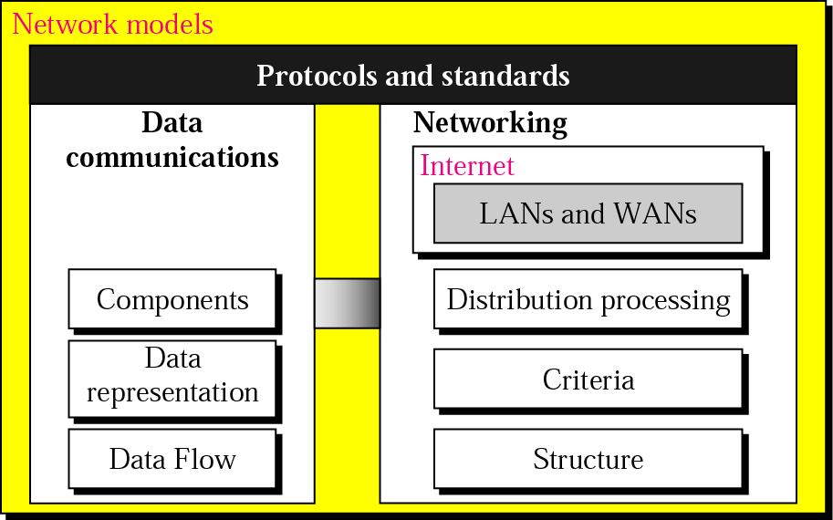
Overview

Slide 3
Network Types
Distinguish one type of network from another by size, geographical coverage and ownership
  Local area network (LAN)
  Wide area network (WAN)

Slide 4
Local Area Network
Private owned
Link the devices in a single office, building, or campus.
Physical distance is limited to a few kilometers.
Allow resources, such as printer and servers, to be shared between personal computers.
LANs are distinguished from one another by transmission media and topology

Slide 5
Local Area Network
Each host in a LAN has an identifier, an address, that uniquely defines the host in the LAN.
A packet sent by a host to another host carries both the source host’s and the destination host’s address.

Slide 6
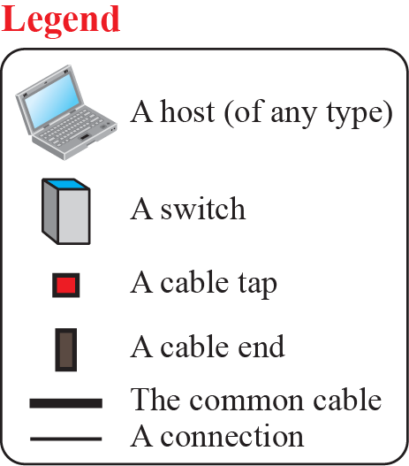
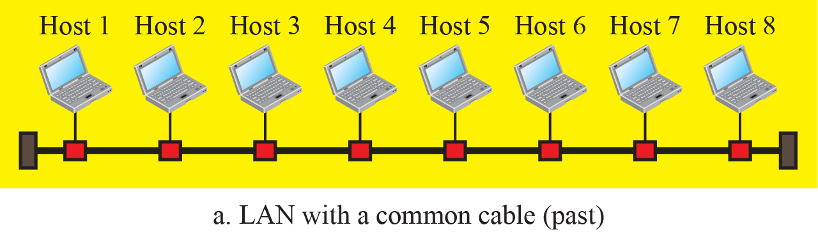
In previous LAN, all hosts in a network were connected through a common cable: a packet sent from one host to another was received by all other hosts.
  The intended recipient keep the packet; the others drop the packet.

Slide 7
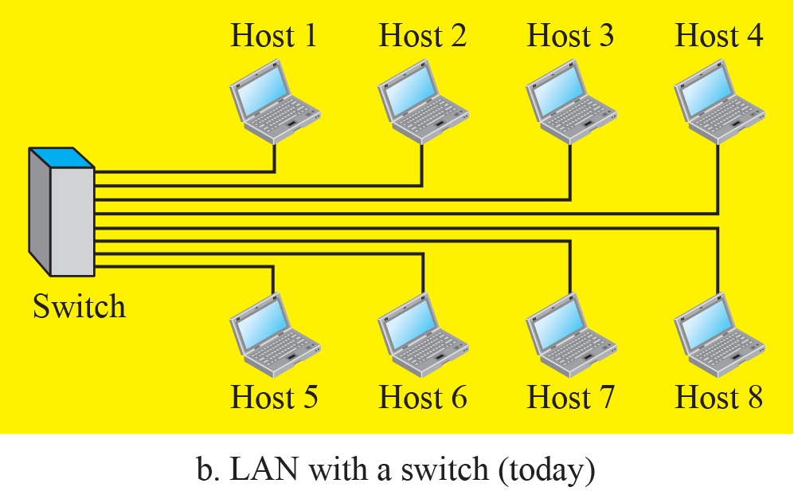
Today, most LANs use a smart connecting switch, which is able to recognize the destination address of the packet and guide the packet to its destination without sending it to all other hosts.

Slide 8
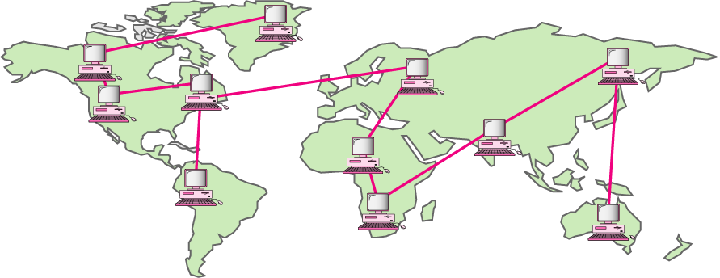
Wide Area Network
A WAN can span a large geographic areas that may comprise a town, a country, a continent, or even the whole world.
A WAN can be
  Switched WAN: Backbone that connects Internet, or
  Point-to-point WAN: A dial-up line that connects a home computer to Internet.

Slide 9
Wide Area Network
A WAN interconnects connecting devices such as routers, switches and modem.
A WAN is normally created and run by communication companies and leased by an organization that uses it.

Slide 10

Two forms of WANs
The simplest: A point-to-point WAN
  A network that connects two devices through a transmission media.
A point-to-point WAN

Slide 11
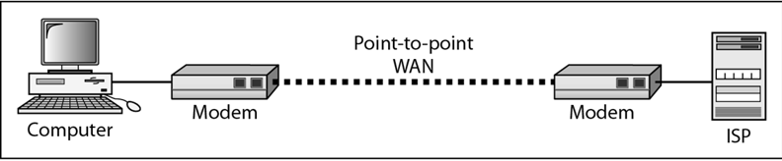
Point to point WAN
Normally a line leased from a telephone or cable TV provider that connect home computer or a small LAN to an Internet service provider (ISP).

Slide 12
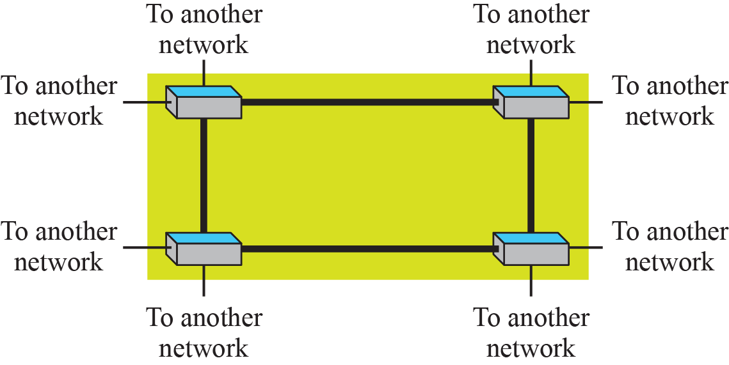
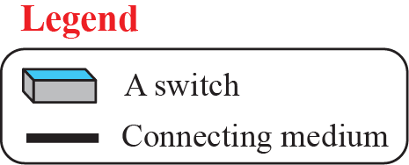
Two forms of WANs
A switched WAN
  Is used in the backbone of global communication today.
  Several point-to-point WANs that are connected by switches
A switched WAN

Slide 13

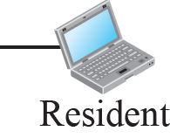
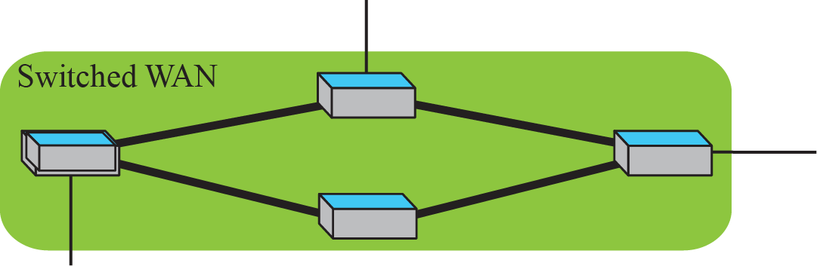
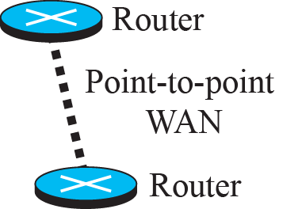
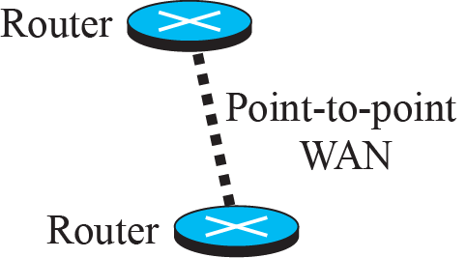
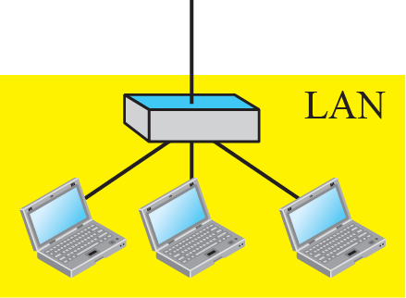
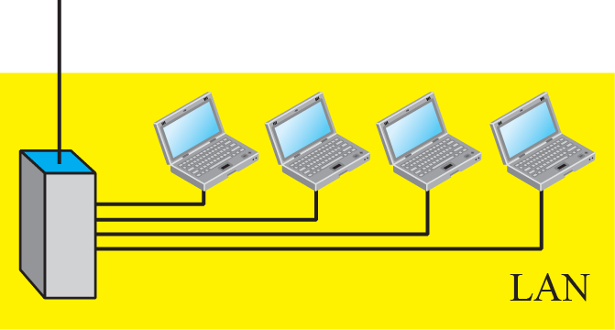
Put together: An internet
An internet is a switched network in which a switch connects at least two links together.
Switching
Network
Broadcasting Network

Slide 14
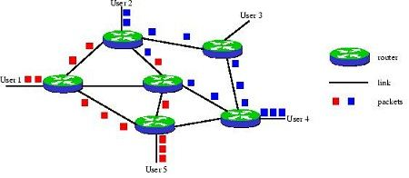
Switching Network

Slide 15

Switching
Any type signal or data element directing or Switching toward a particular hardware address or hardware pieces.

Slide 16
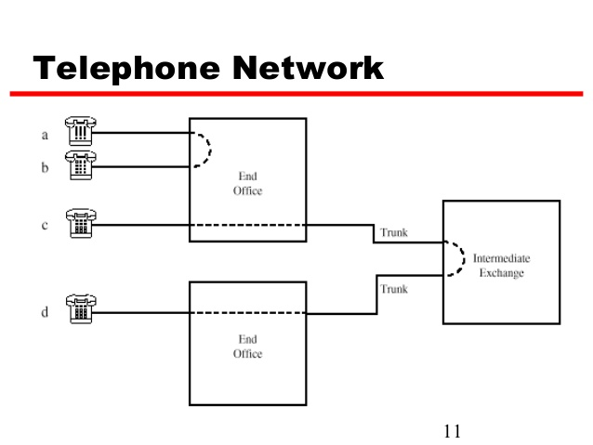
Example (1): Circuit switching network
Call switching

Slide 17
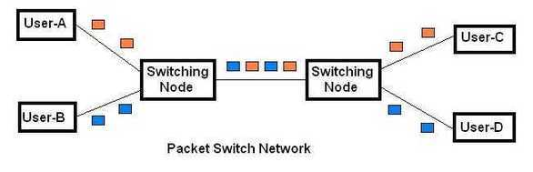
Example (2): Packet switching network
packet switching

Slide 18
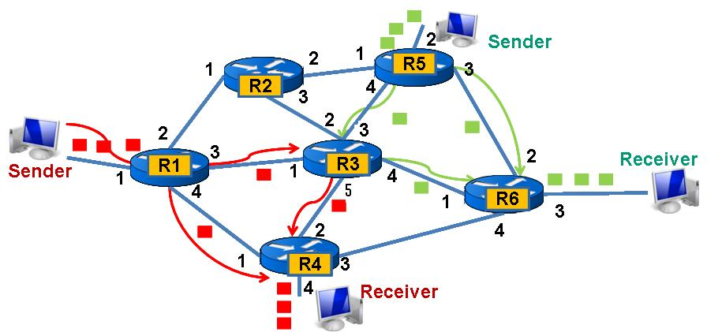
Network Switch
A switch needs to forward data from a link to another link so that the data is closer to destination.

Slide 19
Switching network
A network that connects switches to direct signal or data from one end point to another end point attached to the network.

Slide 20
Two types of switching networks
  Circuit-switched network
  Packet-switched network

Slide 21
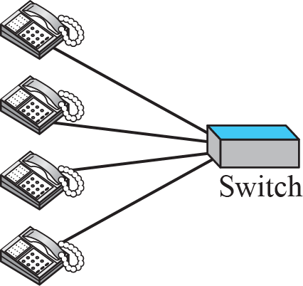
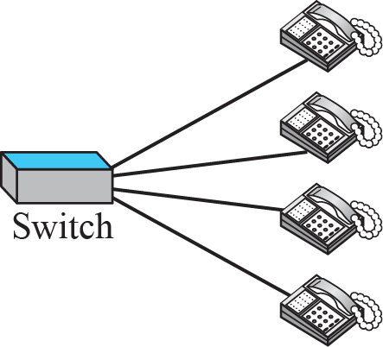

Circuit-switched network
A dedicated connection called a circuit is always available between the two end systems.
Switches can setup a circuit between a pair of users or inactivate it.
The capacity is shared
by 4 phones.

Slide 22

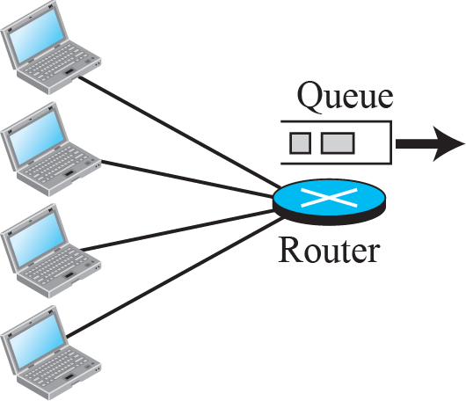
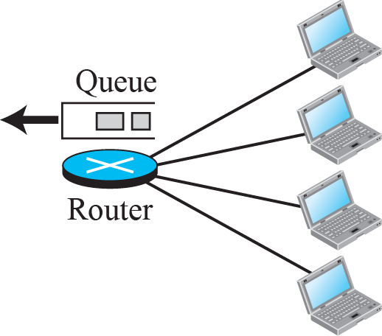

Packet-switched network
Communication between two ends is done in blocks of data called packets.
A packet is stored and forwarded in each switch.
A packet is an entity that can be processed independently.

Slide 23
Queue
A queue is a block of memory structured to store packets being transmitted.

Slide 24
Use of a switching network.
In a switching network, switches work together to find a path between end points.
Switching network does not do data broadcasting and is more efficient.
All WANs are a switching network.

